Slide 1
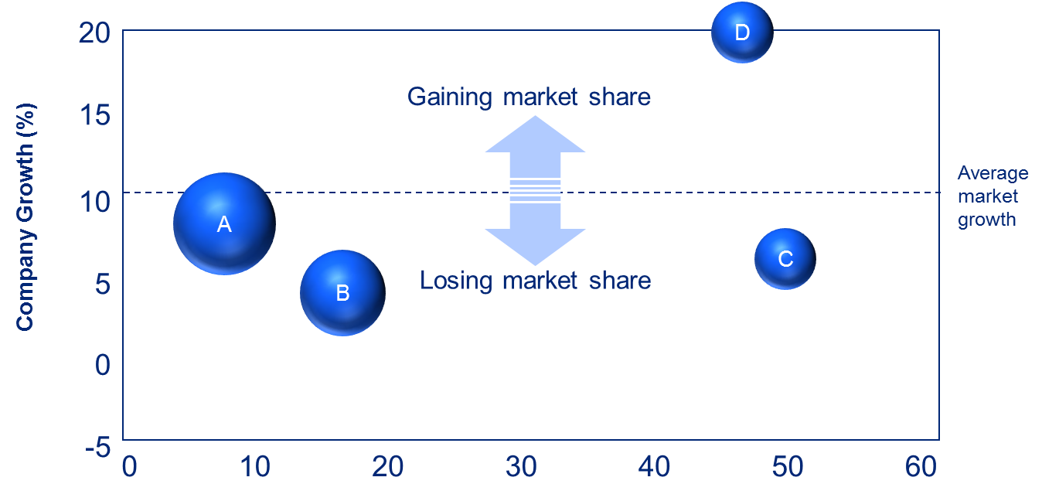

Commercial Due Diligence Training & Templates
Confidential
By Former Deloitte and McKinsey Management Consultants

Slide 2

Table of Contents
1
Key steps to follow during your CDD Project
2
Templates you can easily reused for your own project

Slide 3
Table of Contents
1
Key steps to follow during your CDD Project
2
Templates you can easily reused for your own project

Slide 4
Example of CDD Project Plan
Week 1
Week 2
Week 3
Days
M T W T F M T W T F M T W T F M
Step 1: Background Documents
Step 2: Internal Kick-Off
Step 3: Management meeting
Step 4: Analysis of management data
Step 5: Desk research
Step 6: Interviews
Step 7: Financial Modeling
Step 8: Report preparation and presentation

Slide 5
Step 1: Identify, gather and read background documents
Possible documents involved in a CDD
 | What is it? | Why is it useful?
Information Memorandum | Sale document prepared by Vendor and/or management | Management views, industry context, business overview, historical performance and projections, strategy
Vendor Due Diligence | Financial and sometimes Commercial Due Diligence prepared by advisers to the Vendor | Financial - more detail on business activities, performance, the market and financial position. Commercial – review of market, competitors, customers and a view/rationale behind the business projections. Be wary of VDDs – they can mislead or try to ‘dress up a business’
Specialist market reports | Supplemental specialist reports – e.g. property, environmental, expert and technical reports | More detail on the business in key areas. Tends to be specialist in nature and may require similarly specialist reviewers
VDD presentations | Presentations by report authors with opportunity for Q&A | Chance to ask questions and challenge VDD (approach, data, who spoke to, conclusions). Prepare questions in advance and usually only get one or two chances
Management presentation | Presentation by Management with opportunity for Q&A | Chance to hear Management’s views in their words, form a view on them and ask questions. Usually get one chance so prepare beforehand and work with client/advisers to form a joined-up set of questions and meeting strategy
Trading update | Latest trading performance, often an appendix of the VDD | Up-to-date information on business performance. Beware if this looks late or suspect and ask yourself why

Slide 6
Step 2: Internal Kick-off
Objectives
Meet your team
Establish key role and responsibilities
Ensure a shared understanding of the question we try to answer
Understand the context of the project leveraging the documents read prior to the meeting
Create logic trees to break down the problem into pieces
Run through the scope
Create hypothesis tree including our key hypothesis and assumptions
Talk through the “blank pack”
Present your plan of actions with the “what”, “How”, “Who” and “When”
Discuss key challenges
Prepare for the management meeting
Tips
Ensure that everyone has an open mind
Ensure that everyone has a shared understanding of what needs to achieve and how
It is important to be well-rested as a CDD project can be intense

Slide 7
Step 3: Management meeting
Objectives
Introduce your team and build a relationship with the management team
Hear the management team describe their business and future plans
Ask questions to the management to clarify key points
Build an understanding of what management data might be available and submit a data request
Tips
Ask your consultant to take notes and write down a minutes after the meeting
Bring a USB key

Slide 8
Step 4: Analysis of Management Data
Management Data Analysis
Tips
Objectives:
Extracting management data and carry out detailed data analysis
To build a detailed view of how the company has been performing
To understand how management have built up their forecasts
To identify key areas that require probing with management or through market research
Method:
Via an excel spreadsheet
Outputs:
Chart-Driven Slides that may be included in the final presentation
Quickly draw up data request based on the assumptions you try to validate or invalidate
Sometimes it may be more efficient to ask the management team to request data on your behalf
Analyse initial data by product, business unit, customer, channel, geography, etc.
Understand Management’s forecast model and its underlying assumptions in details
Create chart driven slides to facilitate understanding
If you can’t access some key data, let the management team know asap

Slide 9
Step 5: Desk Research
Desk research
Tips
Objectives:
To identify and gather key sources of information on the industry and company (e.g. Industry report, experts, publications, Industry association, and press comments)
Method:
By searching on the internet, leveraging the “Data Research” team of your company, or by contacting companies such as RMI
Outputs:
Quantitative and qualitative data on the industry and the company
Triangulate: don’t rely just on one source of information
Note all sources of data in you report or in your financial model
Be tenuous as gathering data can be a fastidious task

Slide 10
Step 6: Interviews
Interviews
Tips
Objectives:
Gather primary data
To capture views/opinions on the industry and company
To ask questions on a specific topic
To gain data which may not already exist or may be out of date
Method:
Interviews with Customers, Suppliers, Partners, Competitors, Industry experts, Regulators, etc.
Outputs:
Interview minutes including summary of views and opinions and key quotations
Agree with the management on interviewee list
Organize interviews as soon as possible as people’s agenda can be full
When relevant, ask client to set up the interviews in order to ensure better engagement from the interviewees
Prepare an interview guideline including context, objective, key topics and key questions you want to ask
Be clear on the cover story you are using
Keep questions short
Ask one question at a time
Be neutral in the way you ask questions
Do the least important interview first as a practice
Write up your notes asap, you easily forget
Have a separate excel sheet for quantitative responses
Be careful to maintain confidentiality
Ask if you can call back later if you need any clarification
Identify additional interviewees in order to drill down key areas

Slide 11
Step 7: Financial Modelling
Interviews
Tips
Objectives:
To test the impact of varying key drivers or assumptions of the business model. No need to create a new financial model if the one created by the management makes sense.
Method:
Understand the key assumptions and drivers used by the Management to forecast revenue and cost
Flex the Financial Model key assumptions based on the input of your interviews and Desk research
Outputs:
The Financial Model should be easy to understand and used by someone else than you
For more details on how to create a Financial Model using the proper business norms and rules, please click on the link below when you are using the “Slideshow” mode:
http://www.slidebooks.com/collections/business-templates-1/products/financial-model
Use at least 3 Excel sheets: 1 sheet for your inputs and assumptions, 1 sheet for the calculations and 1 sheet for your output
Avoid hard coding data. If you have no choice but to hard code some data, use a blue font
Take a step back from time to time to ensure that you don’t forget the bigger picture and what you try to achieve

Slide 12
Step 8: Report
Interviews
Tips
Objectives:
The report must answer the initial question in a structured way
The question can be for example:
Are the forecast reasonable?
Is the target company healthy?
Method:
A “ghost” report is usually created at the beginning of the project
The structure of the report usually follow the structure of the Hypothesis tree
The competition of each slide is allocated to someone within the team
Someone is responsible for updating the report based on the different inputs of each project member
Outputs:
A structured report including quantitative and qualitative slides and using an inductive approach and the pyramid principle
For more details on how to create a report using an inductive approach and the pyramid principle, please click on the link below when you are using the “Slideshow” mode:
http://www.slidebooks.com/collections/business-templates-1/products/pyramid-principle
Use a straight forward language easy to understand
Be careful with the words you use. For example, instead of saying the management forecasts are not achievable, say that the forecasts are not consistence with evidence
Create an executive summary at the beginning of the presentation

Slide 13
Table of Contents
1
Key steps to follow during your CDD Project
2
Templates you can easily reused for your own project

Slide 14
Slide Template to present your team
Insert name and position
Insert key role and responsibilities
Insert key role and responsibilities
Insert name and position
Insert key role and responsibilities
Insert key role and responsibilities
Insert name and position
Insert name and position
Insert key role and responsibilities
Insert key role and responsibilities

Slide 15
Slide template to present your CDD Project Plan
Week 1
Week 2
Week 3
Days
M T W T F M T W T F M T W T F M
Step 1: Background Documents
Edit time frame and the name of your key steps depending on your project plan requirement
Step 2: Internal Kick-Off
Step 3: Management meeting
Step 4: Analysis of management data
Step 5: Desk research
Step 6: Interviews
Step 7: Financial Modelling
Step 8: Report preparation and presentation

Slide 16
Slide Template to create a logic tree or hypothesis tree
Text
Text
Text
Text
Text
Text
Text
Text
Text
Text

Slide 17
Slide Template to create a logic tree or hypothesis tree
Text
Text
Text
Text
Text
Text
Text
Text
Text
Text
Text
Text
Text

Slide 18
Slide Template to create a logic tree or hypothesis tree
Your text
Your text
Your text
Your text
Your text
Your text
Your text
Your text
Your text
Your text
Your text
Your text
Your text
Your text
Your text
Insert your text
Your text
Your text
Your text
Your text
Your text
Your text
Your text
Your text
Your text
Your text
Your text
Your text
Your text
Your text
Your text
Your text

Slide 19
Slide Template to create an interview minute
Interview with John Dana
Minutes
Insert Key message
Insert details supporting the key message
Insert quotations using an italic font
Insert Key message
Insert details supporting the key message
Insert quotations using an italic font
Insert Key message
Insert details supporting the key message
Insert quotations using an italic font

Slide 20
Slide Template to create an executive summary
Question
Answer
Insert your own text
Insert your own text
Reason #1
Reason #2
Reason #3
Insert your own text
Insert your own text
Insert your own text
Insert your own text
Insert your own text
Insert your own text

Slide 21
Slide Template to compare the target company with its key competitors
Insert your key message
20
D
15
Gaining market share
Average
market
growth
10
A
Company Growth (%)
C
5
B
Losing market share
0
-5
0
10
20
30
40
50
60
Market Share (%)
= $ xx million in sales

Slide 22
Slide Template to present the company’s revenue and profit forecast
Insert your key message
Revenue and Profit forecast

Slide 23
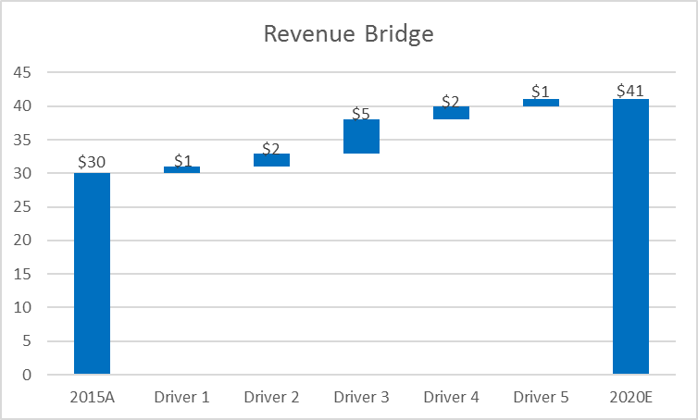

Slide Template to create a revenue bridge using a waterfall chart
Revenue bridge
Comments
Insert your own comments related to the revenue bridge or waterfall chart on the left
Insert your own comments related to the revenue bridge or waterfall chart on the left
Insert your own comments related to the Insert your own comments related to the revenue bridge or waterfall chart on the left
Insert your own comments related to the revenue bridge or waterfall chart on the left
Insert your own comments related to the revenue bridge or waterfall chart on the left
Insert your own comments related to the revenue bridge or waterfall chart on the left
Insert your own comments related to the revenue bridge or waterfall chart on the left
revenue bridge or waterfall chart on the left
Insert your own comments related to the revenue bridge or waterfall chart on the left
Open the Excel sheet “Commercial Due Diligence_Charts” to access the chart

Slide 24
Slide Template to create a revenue bridge using a waterfall chart
Insert the key insight of this chart in this speech bubble
Insert the key insight of this chart in this speech bubble
Insert the key insight of this chart in this speech bubble
Open the Excel sheet “Commercial Due Diligence_Charts” to access the chart

Slide 25

Slide Template to present your revenue forecast and CAGR
Estimate based on revenue driver 1, driver 2 and driver 3
Revenue CAGR of 8% between 2015 and 2020
Open the Excel sheet “Commercial Due Diligence_Charts” to access the chart

Slide 26
Slide Template to create a CAGR tree which represents a high level view of the Target’s financial model
CAGR tree
Comments
Key
Driver A1
A Revenue CAGR tree is a high-level view of the Target’s financial model. It includes the key revenue drivers and assumptions
The revenue can be split based on products, Business Units, geography, customers, etc
A Revenue CAGR tree shows past and projected revenue growth
A Revenue CAGR tree represents the Target’s management projection
CAGR 2010-2015
Value in 2015
CAGR 2015-2020
xx%
xx
xx%
X
= Key assumption
Sales A
Driver A2
xx%
€xxm
xx%
xx%
xx
xx%
+
Driver A3
+
Xx%
xx
xx%
Net Sales
Driver B1
xx%
€xxm
xx%
xx%
xx
xx%
Sales B
+
xx%
€ xxm
xx%
Driver B2
xx%
xx
xx%
+
Driver C1
xx%
xx
xx%
Insert your own text and figures
Sales C
x
xx%
€ xxm
xx%
Driver C2
xx%
xx
xx%

Slide 27
Slide Template to assess the Management’s revenue projection
CAGR tree - Key drivers
Comments
Driver A1
Reasonable: ...
In order to assess the management revenue projection, you need to identify and analyse each key revenue driver
To analyse the key revenue drivers you need to analyse the Company, the Market and the key Competitors
Based on this analysis, you should be able to assess whether or no the assumptions are:
Conservative: your analysis shows that the greater growth is possible
Reasonable: your analysis is in line with the assumptions
Aggressive: your analysis doesn’t support Management assumptions
And finally, based on the assessment of each key revenue driver, you can consolidate and provide an overall assessment
x%
x
x%
+
A
Driver A2
Conservative: ...
x%
x
x%
+
Driver A3
Conservative: ...
+
X%
x
x%
Net Sales
Driver B1
x%
x
x%
Aggressive: ...
B
+
Driver B2
Conservative: ...
x%
x
x%
+
Driver C1
Reasonable: ...
x%
x
x%
C
x
Driver C2
Reasonable: ...
x%
x
x%
PS: The same way you have a Revenue CAGR Tree, you will probably need to create an EBITDA CAGR Tree

Slide 28

Interested in more than 1 Toolkit? Access all our Toolkits for half the price with our Gold Access
Gold Access
Click here to learn more

Slide 29
Thanks for your attention!
www.domontconsulting.com

